Slide 1

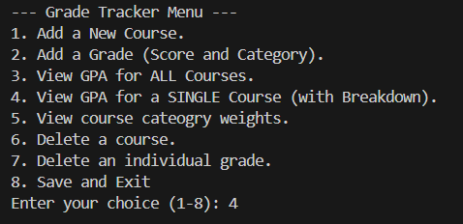
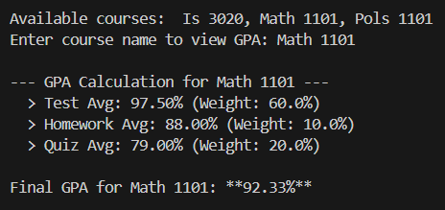
Reed Improved Grade Tracker
Track performance in real-time.
Developer : Benjamin Reed

